Slide 1
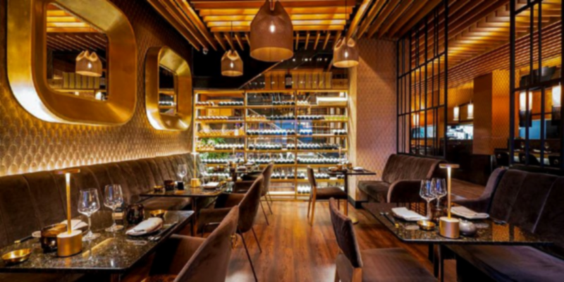

Front Desk
A restaurant billing system with additional features
The welcoming screen of the program,
Where you are required to enter the passcode or pin ( by default set to – 123456 )

Slide 2

First Menu
You are asked to make a selection
Admin gives you some menu management and billing history options

Slide 3

First Menu/Admin Menu

Slide 4
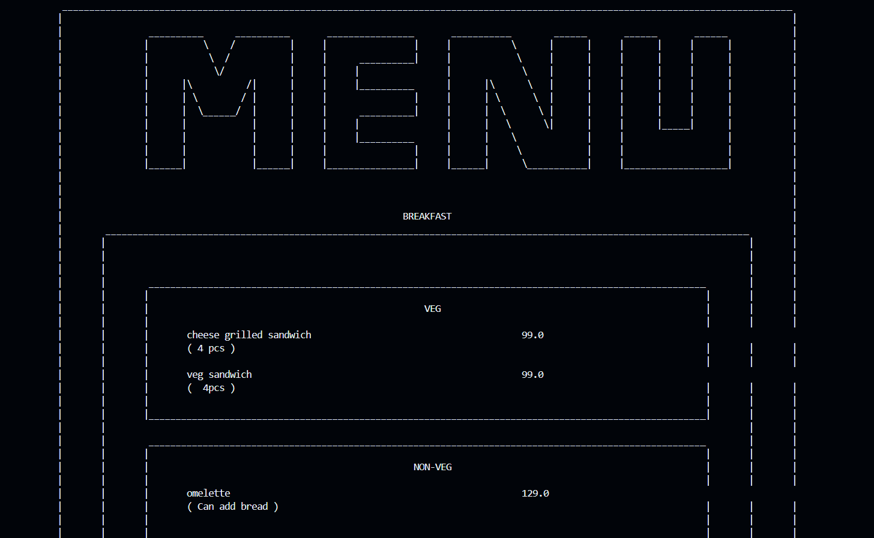
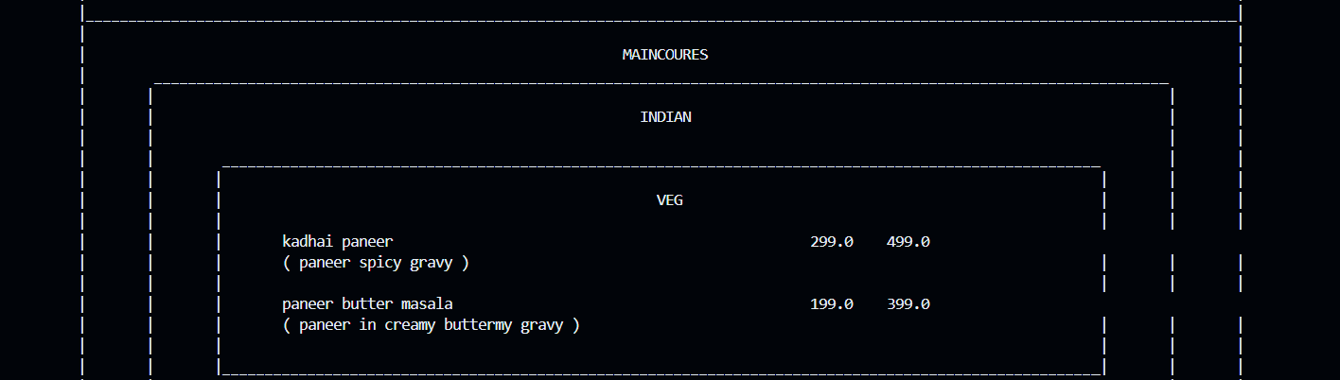
First Menu/Admin Menu/Show menu
This Menu is divided into categories-
Breakfast , maincourse, appetizers
And sub-divided based on locality
Even further has separation of veg/non-veg
.
.
.
.
.
.
.
.
.
.
.
.
.

Slide 5

First Menu/Admin Menu/Edit Menu

Slide 6
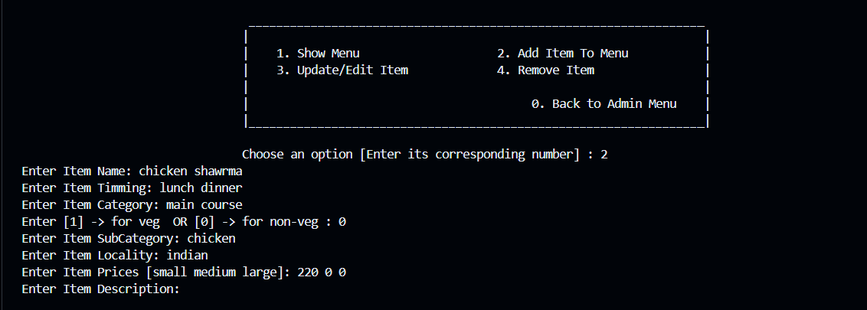
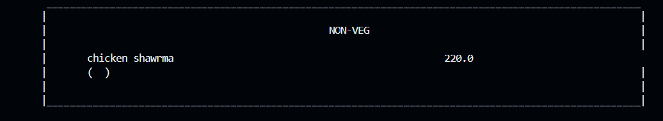
First Menu/Admin Menu/Edit Menu/Add Item To Menu

Slide 7
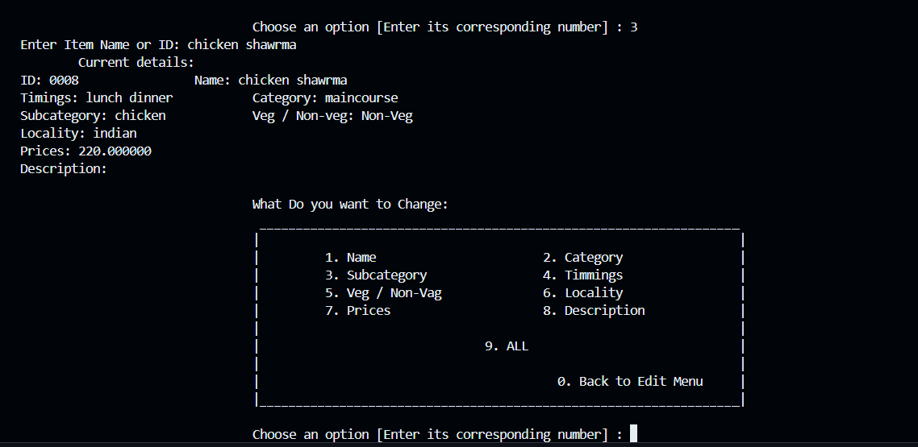
First Menu/Admin Menu/Edit Menu/Update Item

Slide 8
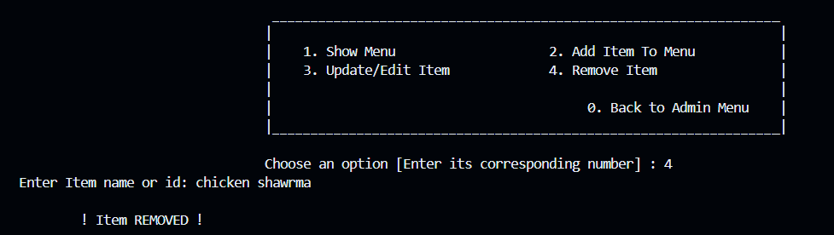
First Menu/Admin Menu/Edit Menu/Remove Item

Slide 9
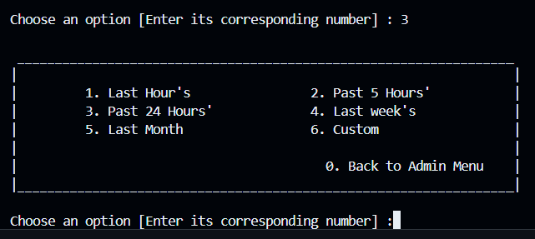
First Menu/Admin Menu/Show BillHistory

Slide 10
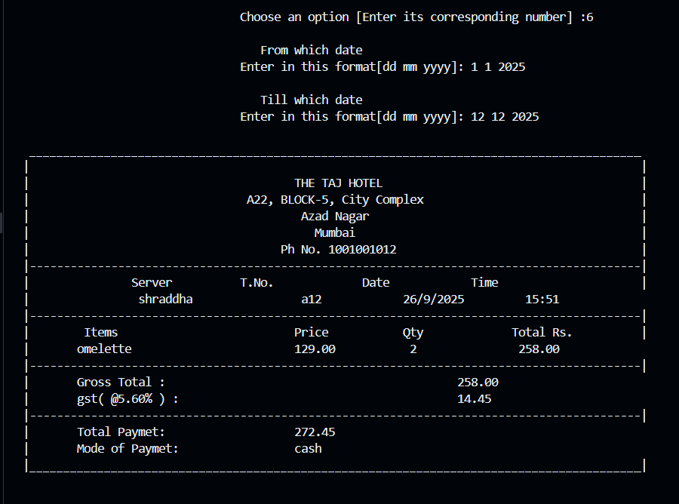
Bill example:

Slide 11
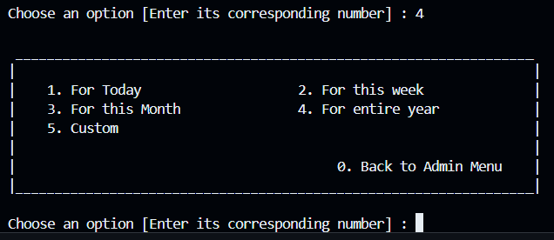
First Menu/Admin Menu/Revenue

Slide 12
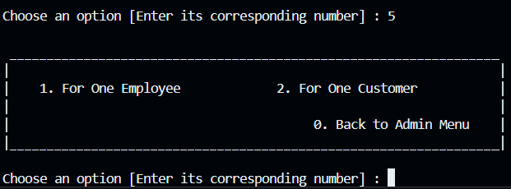
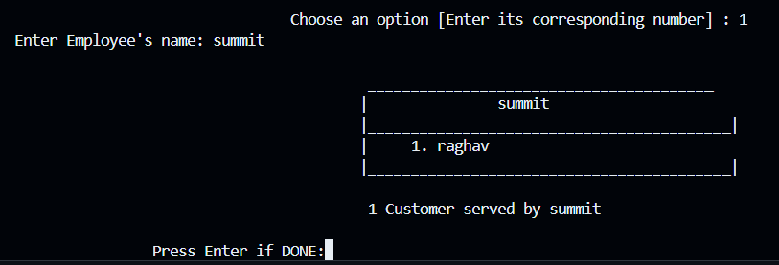
First Menu/Admin Menu/Employees Served Guest

Slide 13
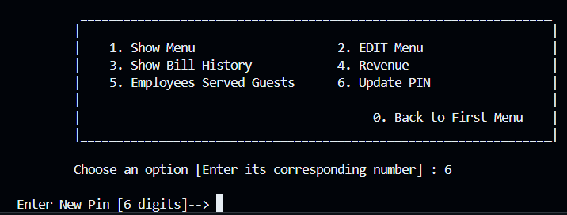
First Menu/Admin Menu/Update PIN

Slide 14
Problems Faced
First challenge was data storage :
First consideration was database, that didn’t workout
So I turned to binary file storage
Second was understanding handling those binary files
Then understanding use of <time.h>
creating better UI

